Slide 1
Second Life
Overview

Slide 2
Agenda
What is Second Life?
Applications in Education
Applications in Health Care

Slide 3
What is Second Life?
3-D Virtual World
Developed by Linden Labs 2003
Residents logged-in last 60 days: 1,404,540
SL is for users 18 years of age and above (Age-Verification)
Teen SL for users 13 to 17 years of age
Residents are known as Avatars
A new personification of a familiar idea
Notes:
3-D virtual world show short movie
3d show short film
Age verification is only required if teleporting to adult rated land. There are 3 main ratings PG, Mature and Adult

Slide 5
SL and Education
Platform for education for many institutions
Offers a more personal touch to traditional distance learning
Provides interactivity and a new dimension to learning
Student comments based on Research Results (Pipitkul, n.d.):
“What I find most exciting about SL is the
chance to interact with others without the space
gaps”
Charinrat Jingjit
“People don’t talk at all when they’re together
in real life, but I didn’t feel like that when I was
in SL.”
Suriyo Wadeesirisak
Notes:
Pipitkul, P., (n.d.). New dimension of online learning resource. ejournals.thaicyberu.go.th/index.php/ictl/article/view/13/14

Slide 6
Universities using SL
Harvard
UF
Stanford
PennState
USF
Brown
NOVA
USC

Slide 7
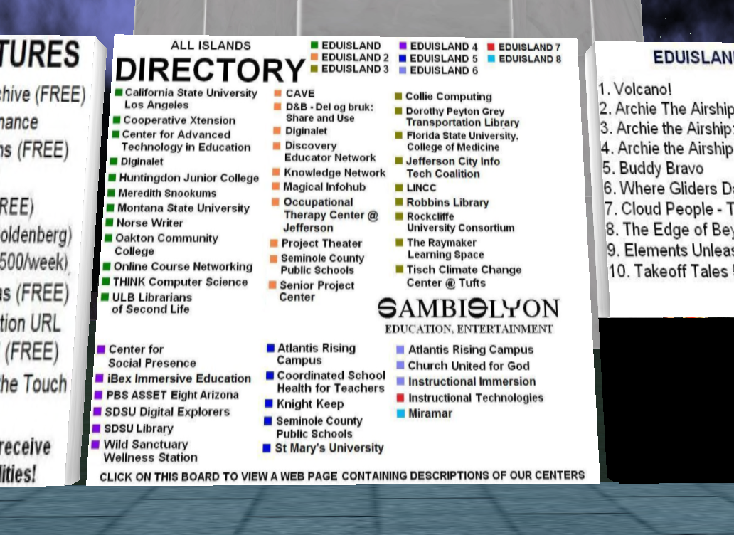

Slide 8
SL and Healthcare
Education and training programs for physicians, nurses and medical students
Disease-specific support and discussion groups
Anonymity and interactivity
“… anonymity makes Second Life a "potentially powerful tool for enabling discourse about personal and private issues, particularly those concerning health.“
"Virtual worlds, like Second Life, offer unique didactic experiences to users seeking health information, skill building and health care training, group support, and, finally, individual consultation,"
Reference: Second Life Health care Options Praised (2009). Research study performed by University of Toronto. http://www.virtualworldsnews.com/2009/05/second-life-health-study.html

Slide 10
Questions?
This concludes this presentation
Thank you for your attention

